Slide 1
CHANGING WORLD OF WORK: Implications for Management, Economics, Law and Health
John Howard
National Institute for Occupational Safety and Health
Washington, D.C.
26 July 2016
National Association of Government Labor Officials
Hilton Garden Inn
Portland, Maine

Slide 2
21st Century Work Characteristics
Engineering + Digital Technology
Miniaturization & Robotization
Smart systems reshaping human-machine relationship
New business structuring focusing on digital work product
Knowledge work that can be digitized can be separated from geography
Resulting in telework, nomadic work, & virtual work;
Reducing hierarchical and geographical barriers, modifying conceptions of space and time and further blurring the line between work and home life.
New Types of Jobs
Short-term, “temporary” jobs through 3rd party leasing/staffing agencies
Short-term, “temporary,” intermediated through an online app
“New” employment arrangements—a matter of perspective
Longstanding temporary work arrangements in blue-collar work are now being “newly” applied to white collar work

Slide 3
Employment: From Stability to Precariousness
Growth of companies created by industrial revolution
Vertical structure differentiated jobs from one another
“Good” job =
Being an “employee” (as American law understands the term) of a particular company for your entire working life until you qualified for a private or social security pension
Government built social welfare laws along same lines
Workers got security, benefits, protections, and steady wage increases
Social Security (1935), FLSA (1938), Medicare (1965), WComp
Companies got stable workforce in which they could invest with a fair expectation of positive returns including retention

Slide 4
Employment: From Stability to Precariousness
Erosion of the Standard Employment Relationship
From internal labor market to external labor market
Rise of “temporariness”
In a triangular or dual employer relationship
Increase in job insecurity
Stress continuum: permanent → downsizing → temporary → unemployment
Decline in social protections
Workers’ compensation, health insurance, wage & hour protections
Disempowerment
Declining unionization in the private sector leading to individualized bargaining between employer and worker
Powerless to exercise legally granted workplace rights
Worker protection laws written based on a mid-20th century model

Slide 5
Old and New Economy Employment Arrangements

Slide 6
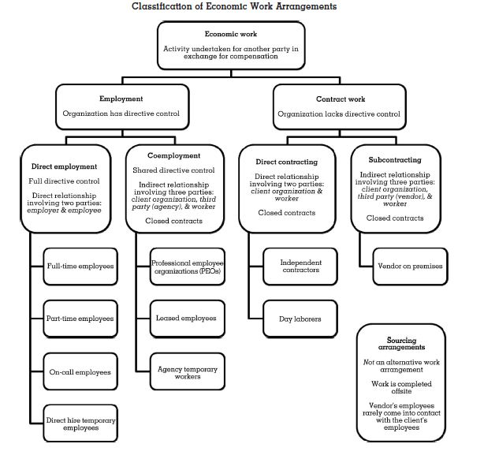
Cappelli, P. (2013). Classifying work in the new economy. Academy of Management Review, 38(4): 575-596

Slide 7
Taxonomy of the New Arrangements
Employment—Organization has directive control
Co-employment—3rd party added to the relationship
Professional employment organization (PEO) workers
Leasing agency workers temporary work
Staffing agency or help services temporary work
Contract Work—Organization lacks directive control
Traditional Independent contractors
New economy “independent contractors”
On-Demand work
Gig work
Online-intermediated work or app-directed work

Slide 8
Eye of the Beholder
Standard Arrangements
Directive control under one employer
Traditional Independent contractor
Non-Standard Arrangements
Directive control under two employers
Online intermediated work
Misclassified independent contractors

Slide 9
How Common Are New Arrangements?
1995—2005 (BLS)
9.3 to 10.1% of total employment is non-standard
2005—2015 (BLS)
10.1 to 15.8% of total employment is non-standard
Represents an increase of 9.4 million over ten year period
Greater than the rise in total employment for same period
Meaning there was a small net decline in number of workers in standard arrangements
Katz, L.F. & Krueger, A.B. (2016). NBER.
2010 National Health Interview Survey
18.7% of 27,157 adults work in non-standard arrangements
Represents ~29 million total US workers (Alterman (2013). Am J Ind Med)
GAO, 2015
Size of the contingent workforce can range from less than 5% to more than 33% of total employed labor force, depending on widely-varying definitions of “contingent” work
“Core contingent” (agency & direct hire temps, on-call, day laborers) workforce 7.9%
JP Morgan Chase (2016)
In a study using financial data from 2012 to 2015, 4.2% of adults, or 10.3 million, earned income from the online platform economy

Slide 10
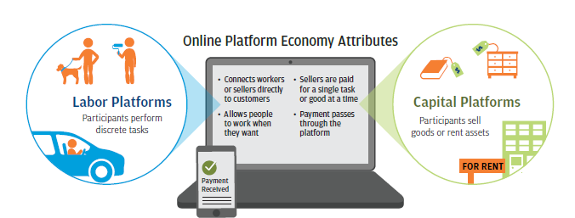
On-Line Platform Economy
Economic activities involving an online intermediary that provides a platform by which independent workers or sellers can sell a discrete service or good to customers.
Labor platforms, such as Uber or TaskRabbit, connect customers with freelance or contingent workers who perform discrete projects or assignments.
Capital platforms, such as eBay or Airbnb, connect customers with individuals who rent assets or sell goods peer-to-peer.
JP Morgan Chase (2016)

Slide 11
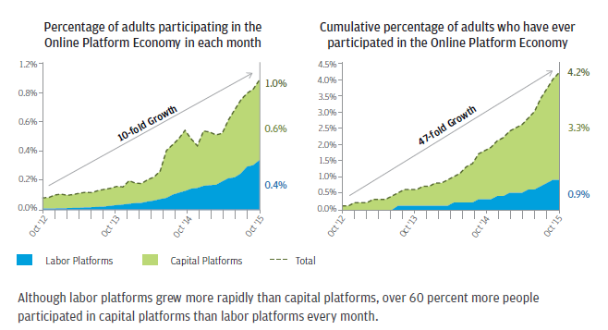
Earning Income from the Online Platform
Only 1% of adults earned income from the Online Platform Economy in a given month, but more than 4 percent participated over the three-year period.

Slide 12
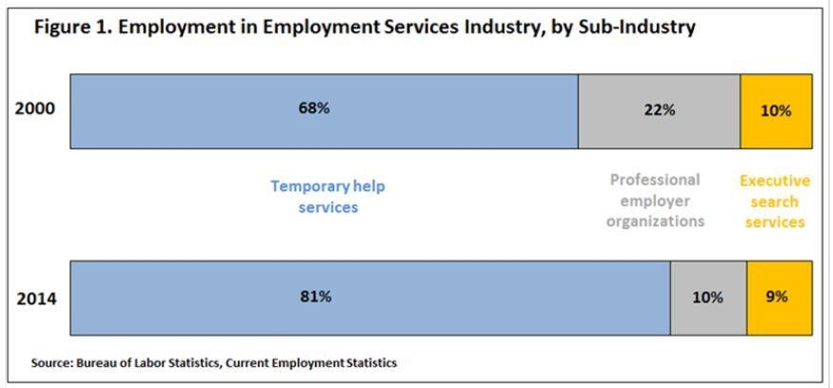
Temporary Services Industry
As a share of the employment services industry, the temporary help industry has grown. In 2000, the temporary help industry accounted for 68% of all employment services industry jobs. By 2014, the share grew to 81%

Slide 13
Firms Using Temporary Workers by Size
Source: American Staffing Association, Client Survey (ASA, 2011)
 | 25-99 Employees | Average 25+ Employees | 100+ Employees
Percent of Firms Using Temporary or Leased Workers | 12% | 15% | 24%

Slide 14
Occupations in Temporary Help Industry, 2014

Slide 15
Temporary Employment by Region

Slide 16
Incentives for Employers to Hire Temps
When Expertise Is Needed
Domestic outsourcing to smaller firm allows firm to tap into expertise
When Flexible Staffing Is Needed
Helps adjust to fluctuations in demand—temps easier to replace
When Costs Need Saving
Cost of expert services less if obtained in the market vs internally
Reduces social protection costs
Health, pension, workers’ compensation, unemployment insurance
When Capital is Needed
Financial markets incentivize corporations to shed all but their core business
Working under corporate brand name, but working for serial subcontractors
Lean management—a contractor can do peripheral tasks cheaper than can primary employer because of specialization

Slide 18
Why People Do Temporary Staffing Work Source: ASA (2014) https://americanstaffing.net/wp-content/uploads/2014/08/Fact_Sheet_Aug_20141.pdf

Slide 19
Issues in New Economic Work: Managerial, Economic, Legal and Health
Management Science
How do organizations decide which arrangements to use?
How do workers in different employment arrangements, but working side by side, alter the social context of work and managers’ ability to get work done?
How are efforts at developing a safety culture affected?
Economics
Western countries taking on features associated with informal economies of less developed countries
Is all temporary work low wage work? It was, but changing...

Slide 20
Toward Higher Skill and Pay

Slide 21
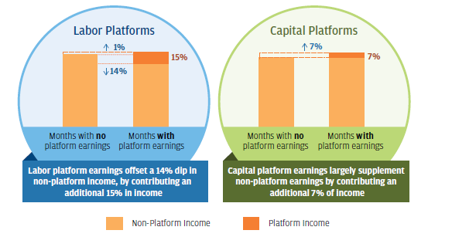
Online Income: Offset vs. Supplement?
Earnings from labor platforms offset dips in non-platform income
Earnings from capital platforms supplemented non-platform income

Slide 22
Legal Issues
Employee or Independent Contractor?
Defining an employee is a complex issue
If large number of workers become contractors, then a company can get an exemption from specific employment laws that society has spent over a century constructing.
Employer Tax Obligations
Employers pay taxes on employees but not on independent contractors, so misclassification of workers may result in tax evasion
Labor Laws
Independent contractors are not protected by most state and federal employment laws, including wage and hour, workers’ compensation

Slide 23
Employee versus Contractor
How to decide if a worker is an employee or not?
OSHA—Common Law Agency Test—Direct and Control (10 factors)
DOL—Economic Realities Test (FLSA)—Consider whether workers are economically dependent on the business for which they labor.
IRS uses a 20 factor test in three areas: (1) behavioral control; (2) financial control; and (3) the relationship of the parties
No one test or grouping of factors has achieved national legal consensus because the definition of employee is adapted to meet the purpose of the individual act which makes for very fact-dependent analysis
Except Congress confined definition of employee under NLRA to the common law definition of employee (“right to control”), excluding independent contractors
The law of the employment relationship remains unsettled
FedEx Home Delivery v. NLRB, DC Circuit, No. 07-1391, 07-1436 (2009).
FedEx Home Delivery, 361 NLRB No. 55 (2014).

Slide 24
Employee versus Contractor
Lawsuits?
Uber drivers suing to gain rights under existing laws, but not winning
Forced mandatory arbitration agreements are getting in the way
Sena v Uber—found arbitration clause to be enforceable in AZ
O’Connor v Uber Technologies, Inc. settlement just prior to class action trial in CA
The Arbitration Fairness Act of 2015
New category for online-intermediated workers? (Harris & Krueger)
Something between employee and independent contractor
True that whether a worker is a legal employee depends on a host of factors, none of which is dispositive.
But scholars argue that such workers can fit in the current definitions of employee (Benjamin Sachs)
Statutory interpretations?
NLRB (AAA Transportation v. Yellow Cab (Tucson Hacks Association))
State and Federal Courts
Wage and Hour Division, U.S. Department of Labor

Slide 25
States: Oregon

Slide 26
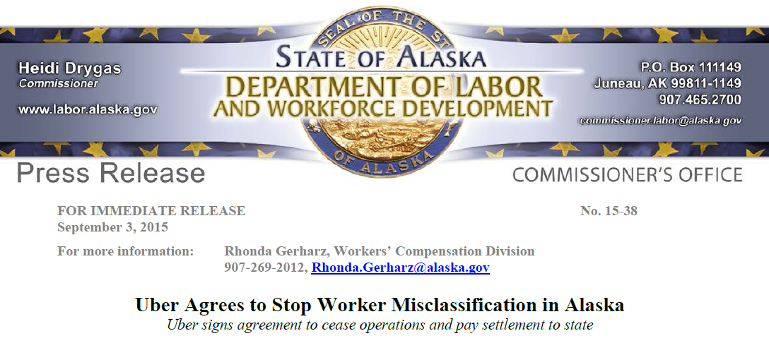
States: Alaska
Uber has agreed not to operate in Alaska unless it classifies drivers as employees or otherwise complies with state law.

Slide 27
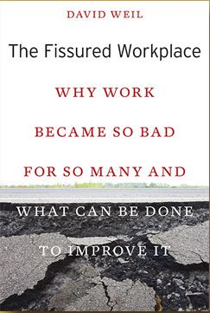
“The Fissured Workplace”
“For many businesses, sustaining the employer-employee relationship ranks below customer relationship management and investor value.”
“Large corporations have shed their role as direct employers of the people responsible for their products, in favor of outsourcing work to small companies that compete fiercely with one another.”
Results:
“Declining wages, eroding benefits, inadequate health and safety protections, and ever-widening income inequality.”

Slide 28
New Guidance from WHD/DOL
Growing variety of alternatives has made concept of “joint employment” more important.
DOL Wage and Hour Division Administrator’s Interpretations
Application of FLSA “suffer or permit” standard in identification of employees who are misclassified as independent contractors—July 5, 2015
Joint employment under FLSA & Migrant and Seasonal Agricultural Workers Protection Act—January 20, 2016
Both promote use of economic realities test to determine who is an employee of which employer.

Slide 30
New Employment Arrangements: Risks to Health

Slide 31
Health: New Economic Work
Health & Safety
Do alternative arrangements impact the health of the people involved in new economic work arrangements?
Is the arrangement itself a risk factor for premature mortality, injury, illness?
To date, limited empirical evidence concerning its health consequences
New Employment → Precariousness → Health
How do you measure precariousness?
Develop a new, theory-based, multi-dimensional tool for epi studies
EPRES
The Employment Precariousness Scale
Psychometric tool measure precariousness in public health research
Health Inequalities Research Group (GREDS)
Vives et al. Occup Environ Med 2010;67:548-555
Vives et al. Gac Sanit. 2015;29(5):379–382

Slide 32
What Are the Exposures Affecting Health?
Temporariness
Duration of current employment
Months working in previous year
Disempowerment
How did you settle your wages or working hours?
Vulnerability
Afraid to demand better working conditions or fair treatment?
Wages
Cover basic needs?
Allow for unexpected expenses?
Rights
Sick, medical & family leave
Paid holiday; Wage and hour protection
Exercise of rights
Can you exercise any of the rights permanent workers have?

Slide 33
Health & Safety Implications Using Differential Risk Analysis
Differential access to social insurance benefits
Unequal lifespans
Work arrangement as a social determinant of health
Mental Health
Specific risks:
Mortality
Morbidity
Injury
Illness

Slide 34
Social Insurance Access
Access to health insurance was 35% lower for workers in new economy employment than standard employees in agriculture
New economy employment is a barrier health insurance and workers’ compensation insurance which may contribute to health inequalities in the longer term.
Asfaw et al. (2014). J Health Disparities Research and Practice, 7(3), 81-97

Slide 35
Unequal Life Spans
Exposure to harmful organizational practices in temp work
Job insecurity
Low job control
High job demands
Low social support at work
Unequal life spans
These exposures may explain significant proportion of observed inequality in life spans in different demographic groups in the U.S.
Goh, J. et al. (2015). Health Affairs, 34, 1761-1768
Enter: Sociology of work as determinants of health
Benach et al. (2014). Precarious employment: Understanding an emerging social determinant of health. Annu Rev Public Health, 35: 229-253.

Slide 36
Employment Type as a Social Determinant

Slide 37
Mental Health
Previous studies on unemployment, organizational restructuring, and forced downsizing have documented an association with psychological ill-health.
A meta-analysis of 27 studies suggests higher psychological morbidity among temporary workers compared with permanent employees
Virtanen, M. et al. Int J Epidemiol. 2005;34:610-622.
Relationship between temporary employment and increased psychological morbidity may reflect the adverse effect of job insecurity, financial instability and other social determinants on mental health.
Ferrie, JE et al. SJWEH Supp. 2008;6:98-110.

Slide 38
Percentage Change in Work Stress by Type of Employment: 2002-2014
Source: NIOSH Quality of WorkLife survey (http://www.cdc.gov/niosh/topics/stress/qwlquest.html)

Slide 39
Percentage Change in Work Stress NIOSH Quality of WorkLife Study
Type of Employment Arrangement | Percent Change in Stress from 2002 to 2014
Standard employment | - 4%
Work under a contractor | - 14%
Paid by a temporary agency | + 48%
On-call work | + 12%
Independent contractor | - 14%

Slide 40
Mortality Risk—Europe
Longitudinal data from 10 towns in Finland—26,592 men and 65,759 women
Overall mortality 1.2-1.6 times higher among temporary employees compared to permanent employees
For alcohol-related causes, hazard ratio was more for men with temporary jobs as was smoking-related cancer.
Corresponding risks were greater for the unemployed
Moving from temp to permanent work associated with lower mortality than remaining continuously in permanent employment
Conventional research practice of treating the employed as a single group may attenuate the association between employment status and mortality!
Kivimaki, M. et al. (2003). Temporary employment and risk of overall and cause-specific mortality, Am J Epidemiology, 158(7), 663-668.

Slide 41
Mortality Risk—U.S.
CFOI
In 2013, Census of Fatal Occupational Injuries (CFOI) reported
17% of all workers killed were working in alternative arrangements
Such workers represented less than 3% of total private sector workforce
NIOSH
Odds of reported fatal incident as opposed to a reported non-fatal incident were 2.8 times higher for contract workers than operators.
Other factors associated with fatality:
Being a contract worker or being more than 8 hours into a working day
Having less overall experience in that specific mine
Contractors had higher reported fatality rates than direct employees but lower reported non-fatal injury rates.
Muzaffar et al., (2013) J Occup Environ Med, 55, 1337-1344.

Slide 42
Morbidity: Injury
European Studies
7 of 13 European reports show increased risk (Virtanen 2005).
U.S. Studies
Higher injury rates in subcontracting turnaround procedures at petrochemical facilities (Rebitzer 1995).
Temps had twice injury rate at a plastics manufacturer (Morris 1999).
Workers’ comp injury claim rates for temps double those of permanent workers in Washington state (Smith 2010).
PROPUBLICA, using Florida workers’ compensation data and BLS data, found an injury odds ratio of close to 4 for temporary workers compared to all other workers (Pierce 2013).

Slide 43
New Employment: Social Consequences
New economy employment increases negative consequences for an injured worker and society, but advantages employers:
Workers ↓
More hazardous work assigned to leased/temporary workers.
Because of a lack of social insurance protections, injured worker might quickly find herself out of a job and, depending on the severity of an injury, the prospects of new employment might be slim.
Society ↓
Employer-based health insurance is a rarity for leased/temporary workers, so the costs of treating injuries are typically shifted to the worker or the public at large through government-sponsored health programs.
Employers ↑
Do not directly pay for workers’ compensation and health insurance—they are insulated from premium adjustments based on the cost of workers’ injuries.
Employers of new economy labor escape the financial incentives that drive decisions to eliminate hazards for other workers.

Slide 44
Morbidity: Illness
European Studies
Finnish study showed that temporary employment was associated with 1.2 to 1.6 times higher all-cause mortality compared with permanent employment
Those who were removed from temporary to permanent had lower mortality than those who remained in temporary employment.
Kivimaki, M. et al. (2003). Am J Epidemiology, 158(7), 663-668.
U.S. Studies
Few studies have been undertaken
National databases do not currently collect information on employment status with any detail to be able to discern health outcomes
Insurer and provider databases may provide some data

Slide 45
Right to Paid Sick Leave
Prevalence of PSL Benefit:
70% of US civilian “full-time” workers have paid sick leave
Only 19% of new economy workers have PSL
PSL Promotes Accessing Healthcare:
Workers without PSL 3 times more likely to forgo medical care for themselves
1.6 times more likely to forgo medical care for their family
DeRigne et al. Health Affairs (2016)

Slide 46
Right to Paid Sick Leave
Injury
28% lower injury likelihood for workers with access to paid sick leave compared to workers without access
Asfaw, A. et al. (2012). Am J Pub Health;102(9):e59-e64
Employee turnover less
Access to PSL could decrease the odds of changing jobs voluntarily by 22% (in press)
Cost savings to employers?
Transmission of contagious diseases less in workplace
Expanding PSL could save employers $0.65 to $1.95 billion per year in 2015 dollars in reduced absenteeism costs from influenza-like illnesses (in press)

Slide 47
Rights: Paid Sick Leave
NIOSH currently examining the business value of providing PSL:
Net (benefits) savings or costs to employers who provide PSL
Evidence of economic returns would help employers make informed decisions about providing or expanding PSL
Research findings to date indicate cost savings
Employers could achieve a net return of $2.44 to $30.93 billion per year in 2015 dollars by investing in paid sick leave
Asfaw, A., Rosa, R., & Pana-Cryan, R. Potential Benefits of Paid Sick Leave (in press).

Slide 48
Executive Order 13706—Labor Day 2015
“Agencies shall, to the extent permitted by law, ensure that new contracts include a clause, which the contractor and any subcontractors shall incorporate into lower-tier subcontracts, specifying, as a condition of payment, that all employees, in the performance of the contract or any subcontract thereunder, shall earn not less than 1 hour of paid sick leave for every 30 hours worked.”
Executive order is effective immediately and shall apply to covered contracts where the solicitation for such contract has been issued, or the contract has been awarded outside the solicitation process, on or after: January 1, 2017
https://www.whitehouse.gov/the-press-office/2015/09/08/executive-order-establishing-paid-sick-leave-federal-contractors

Slide 49
Healthy Families Act
H.R. 932
Would require employers with 15 or more employees to provide workers with up to 56 hours of PSL during each year.
New economy employment, it is undisputed that workers are employees, BUT who are their employers?
Uses Fair Labor Standards Act definition of “employer”
Any person acting directly or indirectly in the interest of an employer in relation to an employee
Economic realities test
More than one employer—joint employers—who is liable?
To decide: some courts have as few as 2, others 4, 5, 6, 7, 8, up to 13 factor tests
● National Federation of Small Business Opposed
Loss of 430,000 jobs over a ten year period
Account for 58% of all jobs lost
Cumulative real output = $652 billion
Small business would bear 50% of lost output

Slide 50
Why the Differential Risks?
New economy jobs are more hazardous than standard jobs
Less experience & familiarity with operations due to short tenure at a worksite
Fewer hours of safety training relevant for the specific job assignment
More distant relationships with longer-term workers who could help navigate worksite hazards
Limited availability & use of personal protective equipment
Less likely to report unsafe conditions because of risks associated with precarious employment
Confusion (real or perceived) about who is responsible for worker safety:
Who is the responsible employer? How do you tell?
Common law test, economic realities test, IRS test, various court cases

Slide 51
Research 1
Agreed on definitions of economic work arrangements
Standard indicators for survey research needed
Precarious, contingent, temporary, alternative, new economy, gig
Definitions of new economy relationships lack standardization across intra- and inter-national databases
Benach et al. (2012)
Improved surveillance about extent of new economy arrangements and number of workers involved in each type is needed
Data challenges in measuring extent of new economy arrangements
Dynamic arrangements
Bernhardt (2014)

Slide 52
Research 2
Are existing models for employment quality that relate to health outcomes useful?
Pressures-Disorganization-Regulatory (PDR) Failure Model
Quinlan, M. et al. (2004).
Employment strain model (demand/control model)
Lewchuk, W. et al. (2008).
Rodger’s multidimensional definition of precarious work
Rogers, G. (1989).
Employment Precariousness Scale (EPRES)(2012).
If so, use a model to:
Organize data and understand links between employment & health
Encourage observation/testing of causal pathways & mechanisms
Identify potential entry points to implement interventions
Benach et al. (2016). What should we know about precarious employment and health in 2025? Framing the agenda for the next decade of research. Int J. Epidemiol, 45(1), 232-238.

Slide 53
Research 3
Possible Studies?
Prospective study of health consequences of new economy employment
Chronic stressor vs shorter isolated exposures
Choice vs. forced
Intervention effectiveness study of a range of policy approaches
Boden et al. (2016)
Emphasize study of the “new” organization of work as distinct research area
NIOSH
Healthy work design and worker well-being (NORA 3)

Slide 54
Some Final Thoughts
Risk from New Arrangements Are Real
Evidence is unequivocal that employers are shifting burden of protecting workers from the things that go wrong in life from them to the worker.
Evidence suggests that workers employed in a triangular arrangements (co-employment) and in the on-demand, internet-mediated economy are at higher risk for occupational safety and health risks than workers in direct employment arrangements or traditional direct contracting.
Better Taxonomy, Better Surveillance and New Research Methods Needed!

Slide 55
OSHA/NIOSH Recommended Practices
8 recommendations for staffing agencies and host employers.
https://www.osha.gov/Publications/OSHA3735.pdf
http://www.cdc.gov/niosh/docs/2014-139/pdfs/2014-139.pdf

Slide 56
DOL/NIOSH Recommendations Agencies and Clients
Evaluate the client employer’s worksite
Train agency staff to recognize safety and health hazards
Ensure the employer meets or exceeds the other employer’s standards
Assign occupational safety and health responsibilities and define the scope of work in the contract
Injury and illness tracking
Conduct safety and health training and new project orientation
Injury and illness prevention program
Maintain contact with workers

Slide 57
Thank You!

